Slide 1
Rethinking a third-place methodology for making sense of the intercultural
Adrian Holliday
Professor of Applied Linguistics & Intercultural Education Canterbury Christ Church University
adrianholliday.com

Slide 2
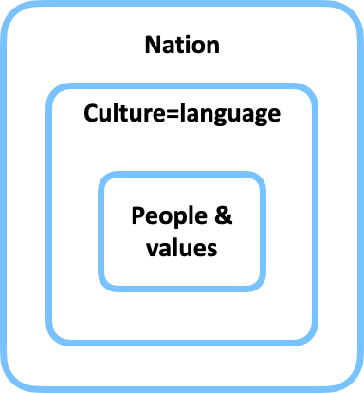
There is a powerful, false, essentialist view of the intercultural
Methodological na.onalism (e.g. Beck & Sznaider 2006; Holliday & MacDonald 2020)
Poli>cal imagina>on that na>on = culture = language
Unfortunate consequence in language teaching - projec>ng L2 = (other, alien) C2 - na.ve-speakerism
Structural-func.onal model of society (Emile Durkheim 1893/1964; Parsons 1951)
Orientalist grand narra.ve imagining outside the West as collec>vist and indolent (Said 1978)
Culture proﬁling is neo-racist (e.g. Hervik 2013; Spears 1999)
The so-labelled ‘non-na>ve speaker’ constructed as uncri>cal without self-direc>on (Holliday 2018; Kubota 2002)
West as steward discourse - ‘helping the rest of the world to think and learn properly’ (Holliday 2019: 128-129; Holliday & Amadasi 2020: 17-20)
- Neoliberal interna.onalisa.on agenda (Caruana 2014; Collins 2018) - ‘you are doing so well’ (as if you brought nothing of value with you)

Slide 3
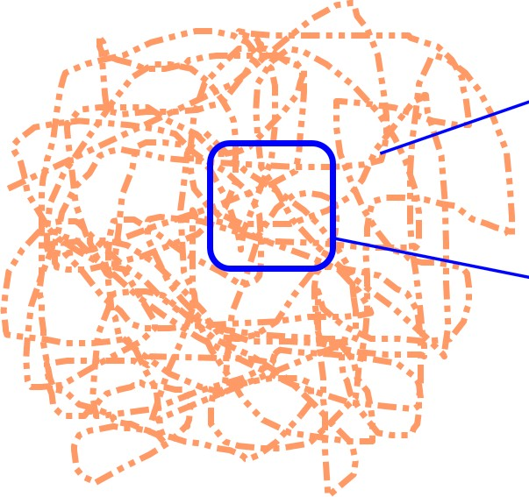
Made evident by deCentred research
A cri.cal cosmopolitan sociology (Delanty et al 2008)
Recognising the excluding ideological poli>cs of the ‘well-wishing’ West
The postmodern turn in qualita>ve research (Cliﬀord & Marcus 1986)
Pudng aside the tradi>onal agendas of imperialism
Recognising the intersubjec.ve implicatedness of the researcher
Making the familiar strange and allowing unexpected reali.es to emerge
Beginning with the small to allow marginalised reali>es to speak (Stuart Hall 1991: 35) - decolonisa>on
An arbitrary slice of human life (Holliday 1999; 2020: 5, 48, 59)
What we see down the microscope for the purpose of research
Has the proper>es of culture in the ﬁgura.ve sense
Crea>ve, ﬂowing, boundary dissolving, changing (Holliday 2020: 12)
Not the cause of social behaviours, but ‘something within which they can be intelligibly - that is thickly -
described’ (Geertz 1993: 14)

Slide 4
Our major resource in intercultural travel
Intercultural experience from childhood
Going to school, the family next door, meal>mes, new groups and jobs (Holliday 2019)
Travelling between small languages as discourses (Lankshear et al 1997)
Underlying universal cultural processes - the same people in diﬀerent circumstances
Small culture forma.on on the go
The transient site of intercultural engagement - making sense, joining, rejec>ng
Not a norma>ve community of prac>ce - messy, poli.cal interculturality (Dervin 2016)
Finding deCentred threads of hybridity
We are all many things
Replacing na>onal iden>>es for all of us (Stuart Hall 1996: 619)
The nature of culture per se (Homi Bhabha 1994: 56)
‘Upsurge of new forms of life’ (Guilherme 2002: 128)
Poten>al for shared experience
Choosing to talk to a Chinese colleague about childcare and work-life balance (Holliday 2016: 322; 2020: 34; Holliday & Amadasi 2020: 53)
Challenging essen.alist statements - ‘In my culture we don’t …’

Slide 5


But the false essentialism doesn’t go away
Auto-ethnography of my travel to Iran in the 1970s
Extremely foreign
No social media or easy telephoning
At the beginning of my adult life - marriage, paren>ng, career, driving
To test what it takes to ﬁnd deCentred threads
Loca>ng an Orientalist grand narra.ve brought unconsciously from my childhood
In cinema, my educa>on, childhood stories, na>onal narra>ves
Our ancestors the Greeks: Spartan self-control
The ‘evil empire’: Persia, Egypt in The ten commandments, Islam, Catholic Spain, and science ﬁc>on
John Carter rescuing Dejah Thoris
Flash Gordon vs. Ming the Merciless
The right to travel: explorers, adult and child adventurers, the Foreign Legion
To civilise and represent the Other

Slide 6
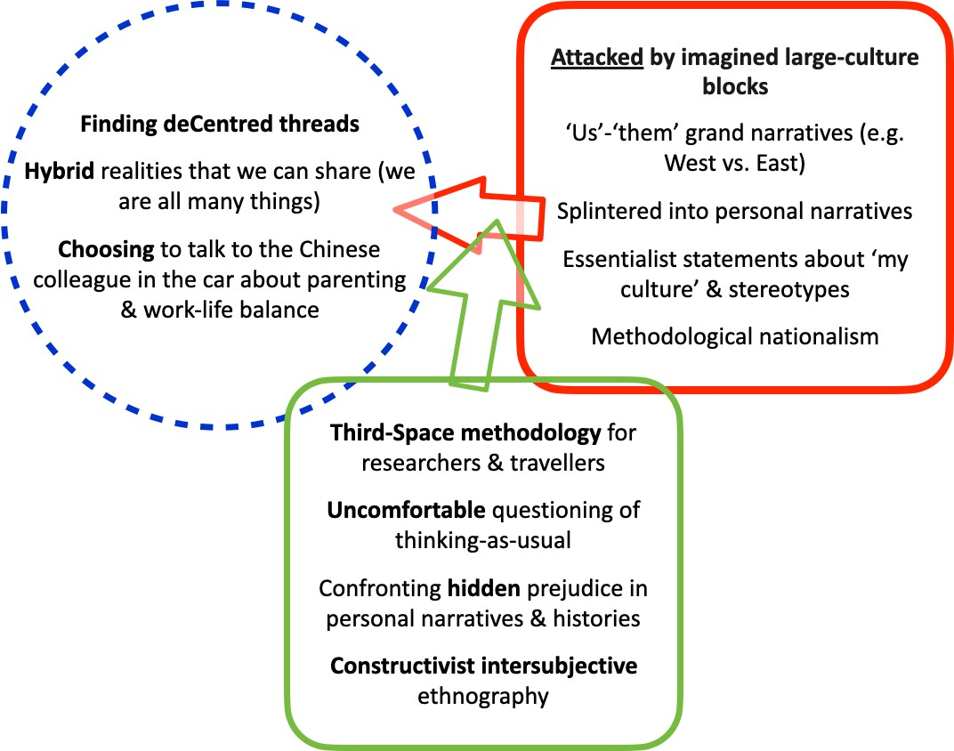
Third-Space methodology

Slide 7
Third Space?
Rethinking what this might mean
Can no longer be a thinking space between large, bounded, na>onal or civilisa>onal cultures
Diﬀerence without hierarchy and ﬁxity, ’others out of selves’ (Homi Bhabha 1994: 5, 94, 56)
‘New rela.ons of self, other and world … in the moments of openness’ (Delanty 2006: 33)
Inser.ng researcher trajectory into ‘data’ (Badwan & Hall 2020; Ros i Solé 2019)
Cri.cal postcolonial ﬁc.on that shakes our common percep>on (Lalami 2015; Mami 2017)
Thinking-as-usual ’suﬃciently disturbed to enable deCentring’ (Holliday & Amadasi 2020: 8)
The analy.cal third
The possibility of unexpected thoughts arising from reverie between the analyst and analysand in psychoanalysis
- ‘the cusp of the past and the present … created anew’, ’recognising the individuality of the analysand’ and their ‘recogni>on of the separate individuality of the analyst’ and ‘their interpreta>ons’ (Ogden 2004: 178, 191)
Transient re-assessing of thinking-as-usual (George Simmel 1908/1950)
The third script
‘One script he could read but no-one else! The second both he and others could read. But the third neither he nor anyone else could read! That third is myself!’ (Shams-e Tabrizi c.1247)

Slide 8
Towards a methodology
Autoethnography - me, the researcher as the analysand
But also as a separate, analy.c text (Anderson 2006), so I can stand back and allow reverie
Working out how it is inﬂuenced and constructed in response to grand and splintered narra.ves and other texts
Time travel of experience - Oliver Stone’s Alexander (2004) informing memories of The Ten Commandments (1956) and school texts about Sparta
The Persians are ‘an inferior race’
The ‘oriental races are known for their barbarity and their slavish devo.on to their senses and excess in all things’
‘We Greeks are superior, we prac>se control of our senses, modera.on’
‘The Persian soldiers do not ﬁght for their homes but because this king tells them they must’
Persian women may ‘fool us with their beauty and degrade our souls’
The Greeks are there to ‘free the people of the world’
But applies to all data forms
The interview text is also set up, selected and curated by the researcher
The researcher’s narra.ves are as much part of the data as the person who ‘spoke it’
Researchers are as much intercultural travellers, in need of third-space interven.on

Slide 9
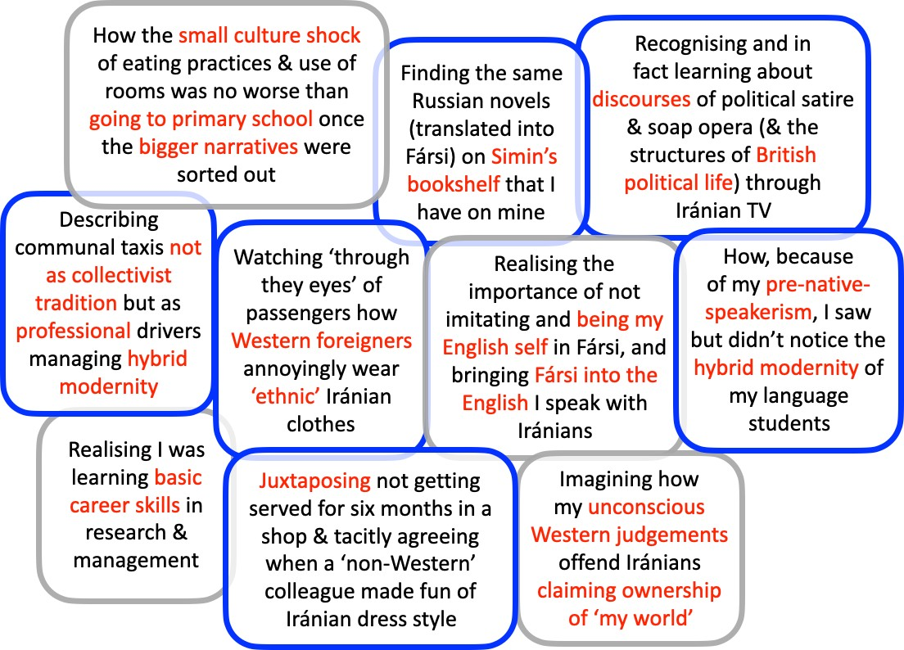
Sample thick description

Slide 10
How diﬀerent is travel from and to ‘the West’, and anywhere?
The Orientalist grand narra.ve or similar is everywhere
Inﬂuences false deﬁcit images of ‘my culture’, brought by ‘interna.onal’ students
and believed by tutors who think they ‘must know their context’ because they are ‘collec>vist’
- Every na.onal educa.on system educates its ci.zens to look nega.vely or posi.vely at other na.ons
These essen.alist ‘us’-‘them’ narra.ves of culture are as deeply rooted in everyday life and language as those of gender and race
We cannot begin to achieve intercultural awareness at na.onal level un.l we have addressed how we imagine each other everywhere, every day

Slide 11
Bibliography
Anderson, L. (2006). Analy>c autoethnography. Journal of contemporary ethnography 35/4, 373-395.
Badwan, K. & Hall, E. (2020). Walking along in s>cky places: post-humanist and aﬀec>ve insights from a reﬂec>ve account of two young women in Manchester, UK. Language & Intercultural Communica>on online/, 1-15.
Beck, U. & Sznaider, N. (2006). Unpacking cosmopolitanism for the social sciences: a research agenda. Bri>sh Journal of Sociology 57/1, 1-23.
Bhabha, H. K. (1994). The loca>on of culture. Routledge.
Caruana, V. (2014). Re-thinking global ci>zenship in Higher Educa>on: from cosmopolitanism and interna>onal mobility to cosmopolitanisa>on, resilience and resilient thinking. Higher Educa>on Quarterly 68/1, 85-104.
Cliﬀord, J. & Marcus, G. E. (Eds.) (1986). Wri>ng culture: the poe>ca of poli>cs of ethnography. University of California Press. Collins, H. (2018). Interculturality from above and below: naviga>ng uneven discourses in a neoliberal university system.
Language & Intercultural Communica>on 18/2, 167-183.
Delanty, G. (2006). The cosmopolitan imagina>on: cri>cal cosmopolitanism and social theory. Bri>sh Journal of Sociology 57/1, 25-47.
Delanty, G., Wodak, R. & Jones, P. (Eds.) (2008). Iden.ty, belonging and migra.on. Liverpool University Press. DeMille, C. B. (1956). The ten commandments. Paramount Pictures.
Dervin, F. (2016). Interculturality in educa>on. Palgrave Macmillan.
Durkheim, E. (1893/1964). The division of labour in society. Simpson, G., Trans. Free Press. Geertz, C. (1993). The interpreta>on of cultures. Fontana.
Guilherme, M. (2002). Cri>cal ci>zens for an intercultural world: foreign language educa>on as cultural poli>cs. Mul>lingual Maqers.
Hall, S. (1991). The local and the global: globalisa>on and ethnicity. In King, A. D. (Ed.), Culture, globalisa>on and the world- system, 19-39. Palgrave.
--- (1996). The ques>on of cultural iden>ty. In Hall, S., Held, D., Hubert, D. & Thompson, K. (Eds.), Modernity: an introduc>on to modern socie>es, 595-634. Blackwell.
Hervik, P. (2013). Racism, neo-racism. In ENAR (Ed.), Recycling hatred: racism(s) in Europe today: a dialogue between academics, equality experts and civil society ac>vists, 43-52. The European Network Against Racism.

Slide 12
Holliday, A. R. (1999). Small cultures. Applied Linguis>cs 20/2, 237-264.
--- (2016). Diﬀerence and awareness in cultural travel: nego>a>ng blocks and threads. Language and Intercultural Communica>on 16/3, 318-331.
--- (2018). Na>ve-speakerism. In Liontas, J. (Ed.), TESOL Encyclopedia of English Language Teaching. Wiley.
--- (2019). Understanding intercultural communica>on: nego>a>ng a grammar of culture. 2nd ed. Routledge.
--- (2020). Blogs 2013-2020: How it is possible to write - Issues with culture. adrianholliday.com/books. Holliday, A. R. & Amadasi, S. (2020). Making sense of the intercultural: ﬁnding deCentred threads. Routledge.
Holliday, A. R. & MacDonald, M. N. (2020). Researching the intercultural: intersubjec>vity and the problem with postposi>vism. Applied Linguis>cs 41/5, 621-639.
Kubota, R. (2002). (Un)ravelling racism in a nice ﬁeld like TESOL. TESOL Quarterly 36/1, 84-92. Lalami, L. (2015). The Moor’s account. Kindle ed. Periscope.
Lankshear, C., Gee, J. P., Knobel, M. & Searle, C. (1997). Changing literacies. Open University Press.
Mami, F. (2017). Possibility of relapse in transi>on: the case in Leila Lalami's ﬁc>on. Paper presented at the 4th Humani>es Conference, A Na>on in Transi>on, Community College of Qatar.
Ogden, T. H. (2004). The analy>c third: implica>ons for psychoanaly>c theory and technique. Psychoanaly>c Quarterly 73/, 167-195.
Parsons, T. (1951). The social system. Routledge and Kegan Paul.
Ros i Solé, C. (2019). Re-visi>ng the unhomely through languaging. Language and Intercultural Communica>on 19/1, 38-50. Said, E. (1978). Orientalism. Routledge & Kegan Paul.
Simmel, G. (1908/1950). The stranger (Wolﬀ, K., Trans.). In Wolﬀ, K. (Ed.), The sociology of George Simmel, 402-408. Free Press.
Spears, A. K. (Ed.) (1999). Race and ideology; language, symbolism, and popular culture. Wayne State University Press. Stone, O. (2004). Alexander. Warner Brothers Pictures.

